Slide 1
Analysis of Interest Rates With USD and CAD LIBORS

Slide 2
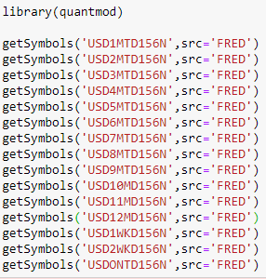
About the LIBOR
The London interbank offered rate represents the interest rate at which banks offer to lend funds to one another in the international interbank market for short-term loans.
LIBOR is based on 5 currencies :the US dollar (USD), euro (EUR), British pound (GBP), Japanese yen (JPY), and Swiss franc (CHF)
The three-month U.S. dollar rate is the most commonly quoted rate and is referenced as the “current LIBOR rate”.
Getting the LIBOR data
Quantmod is a package designed for R.
It is a rapid prototyping environment, with comprehensive tools for data management and visualization where quant traders can better explore and build trading models.
All the data concerning USD and CAD were downloaded from Federal reserve bank of St Louis

Slide 3
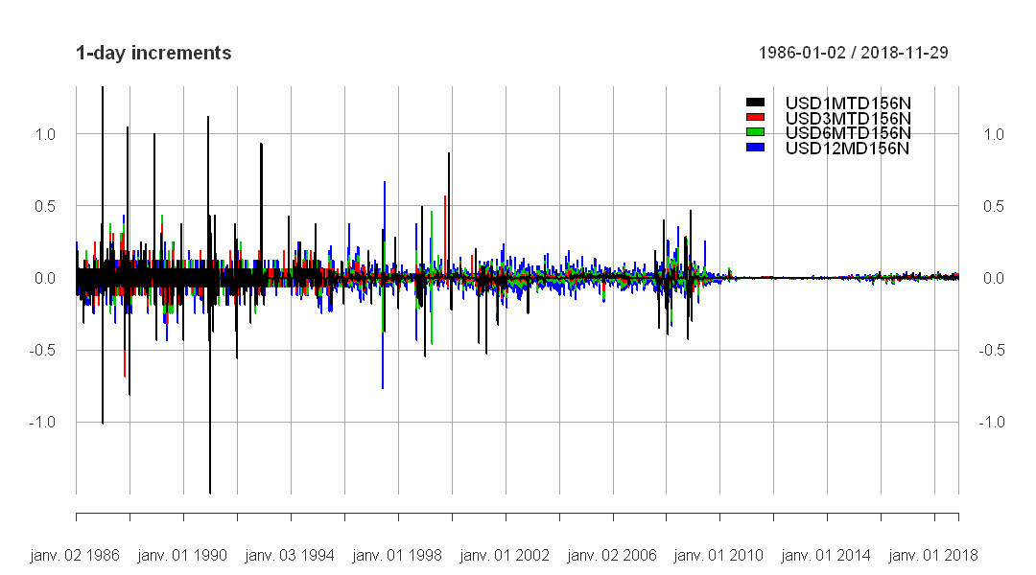

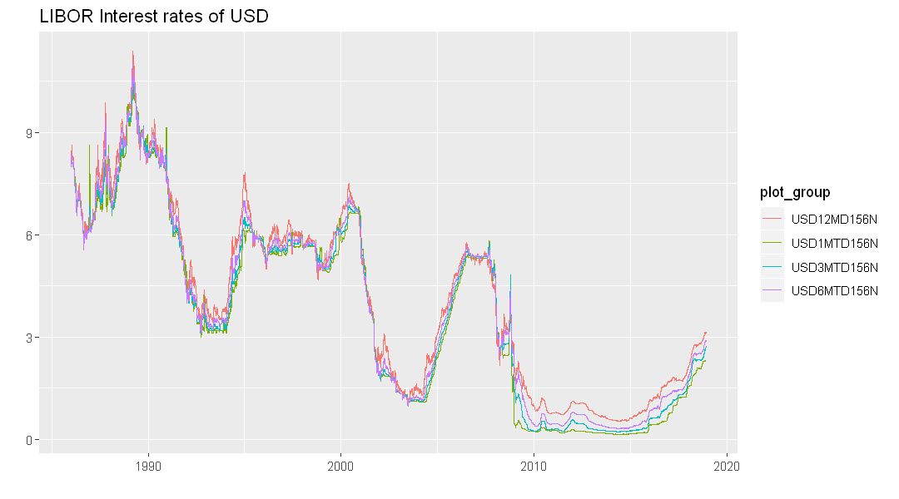
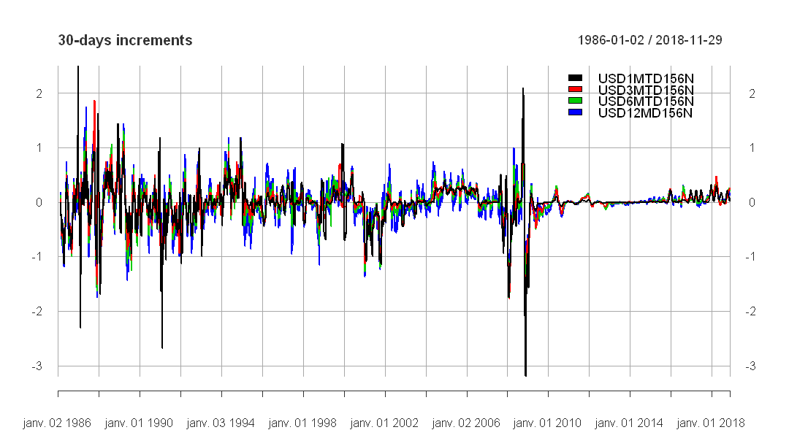
Plots of IR in different tenors and their 1-day and 30 days increments
To remove a trend and make a time series stationary, we use the diff() method.

Slide 4
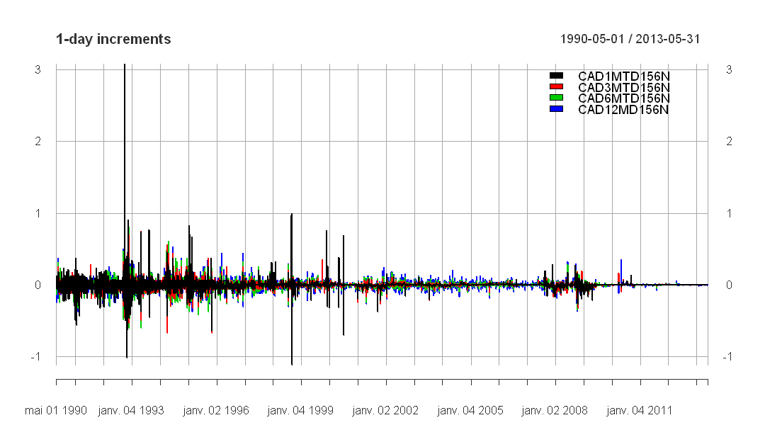
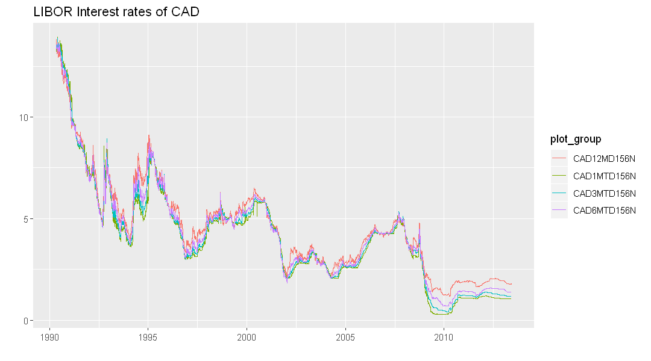
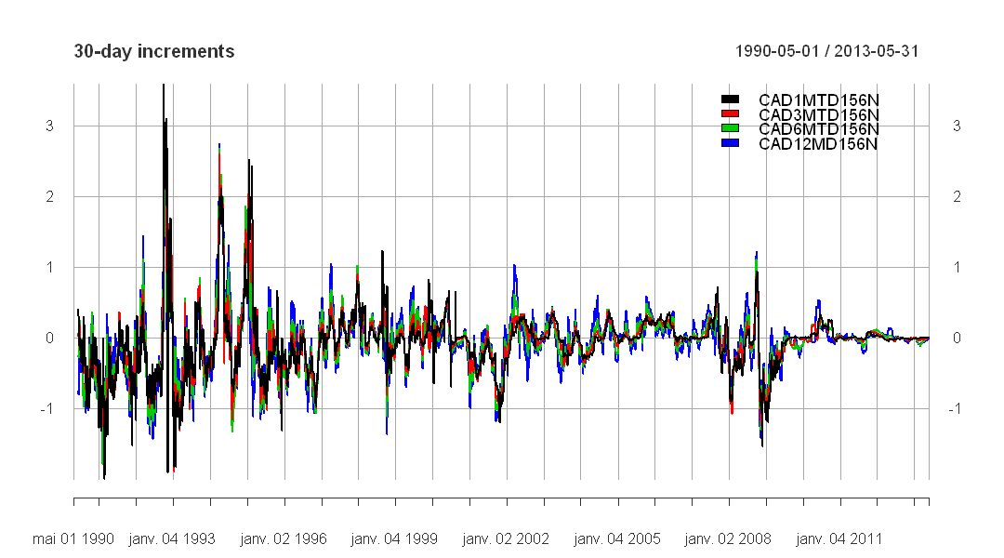

Slide 5
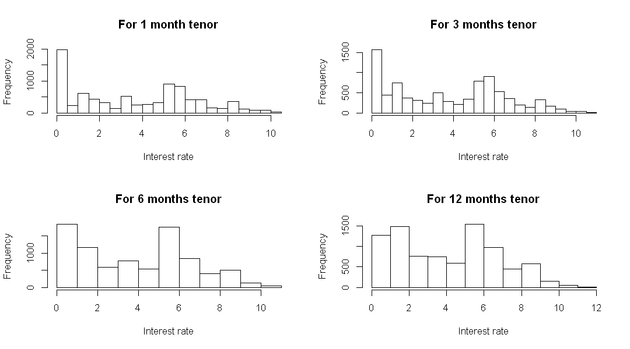
For USD

Slide 6
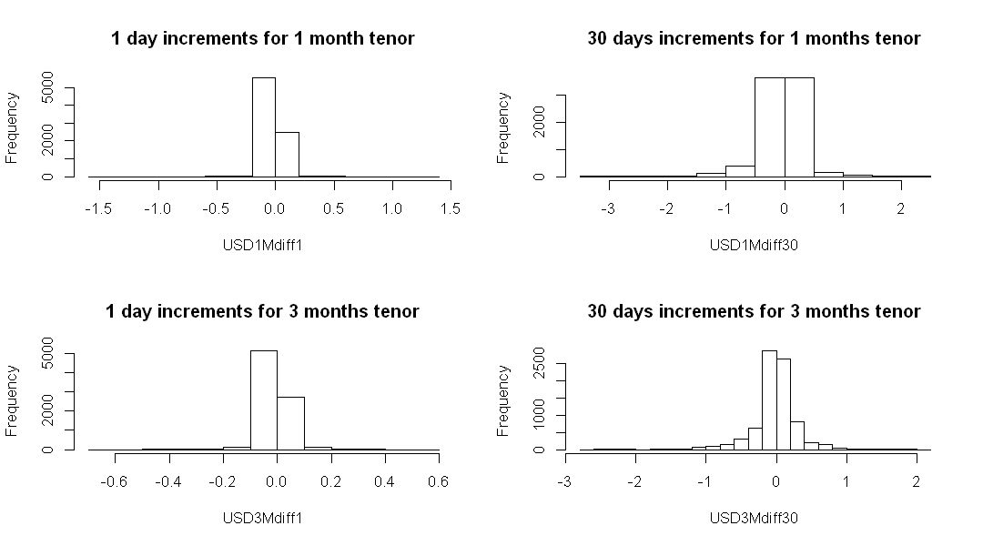
For USD

Slide 7
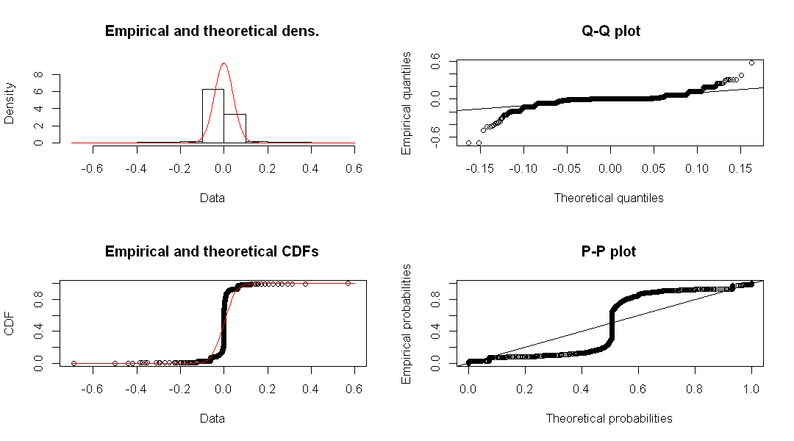
For USD and 3 months-tenor on 1 day increments only

Slide 8
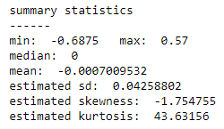
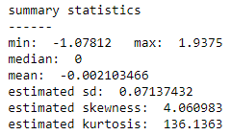
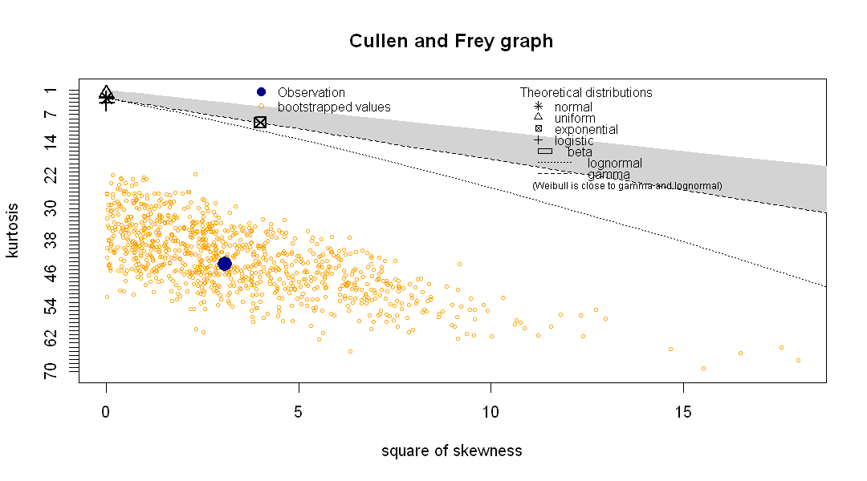
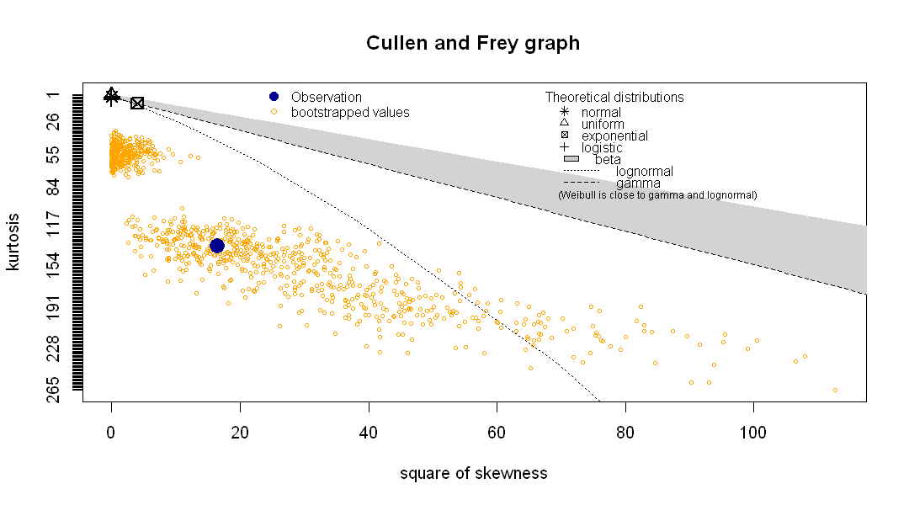
For 1 day increments only
For USD
For CAD

Slide 9
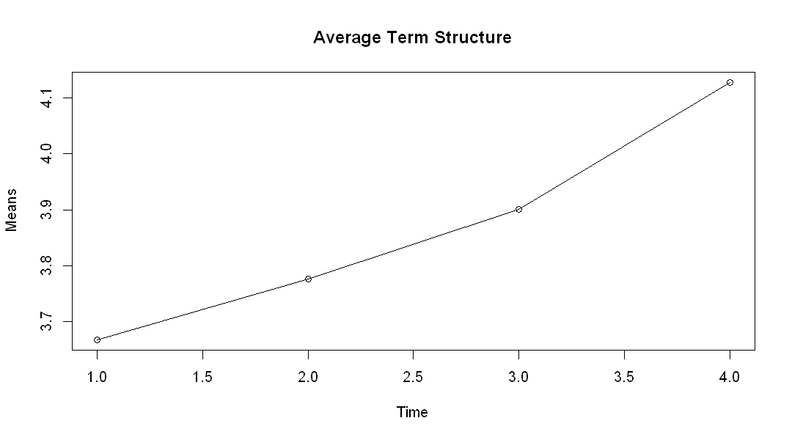
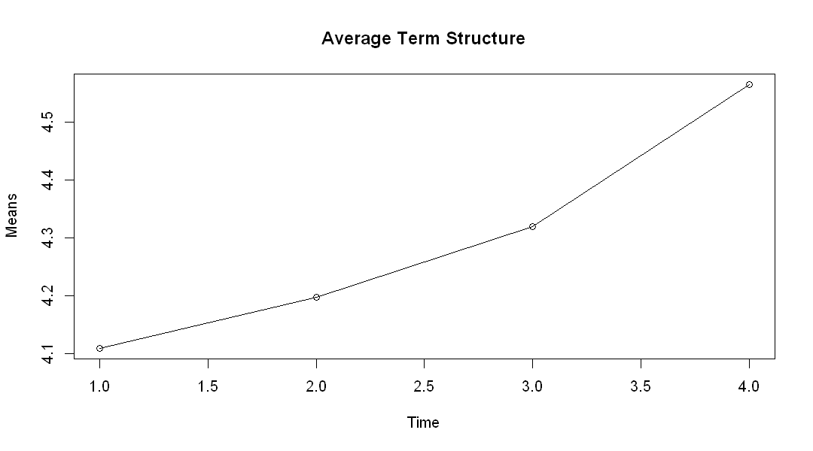
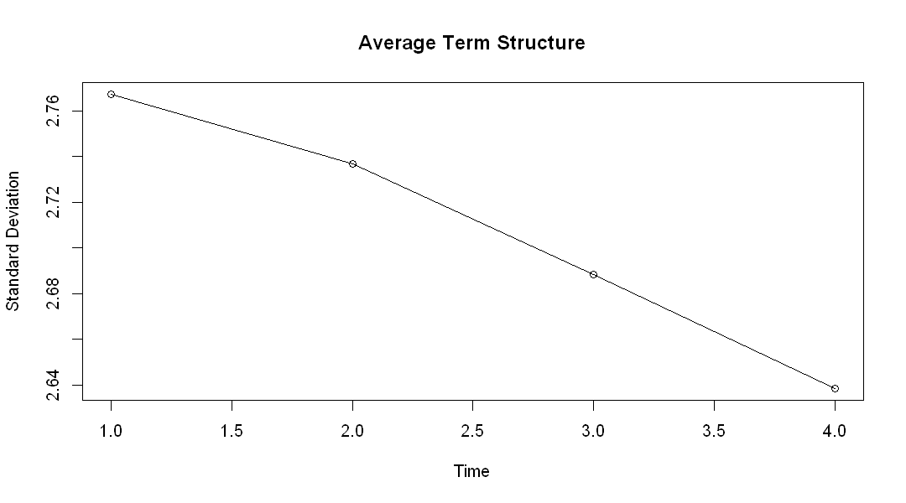
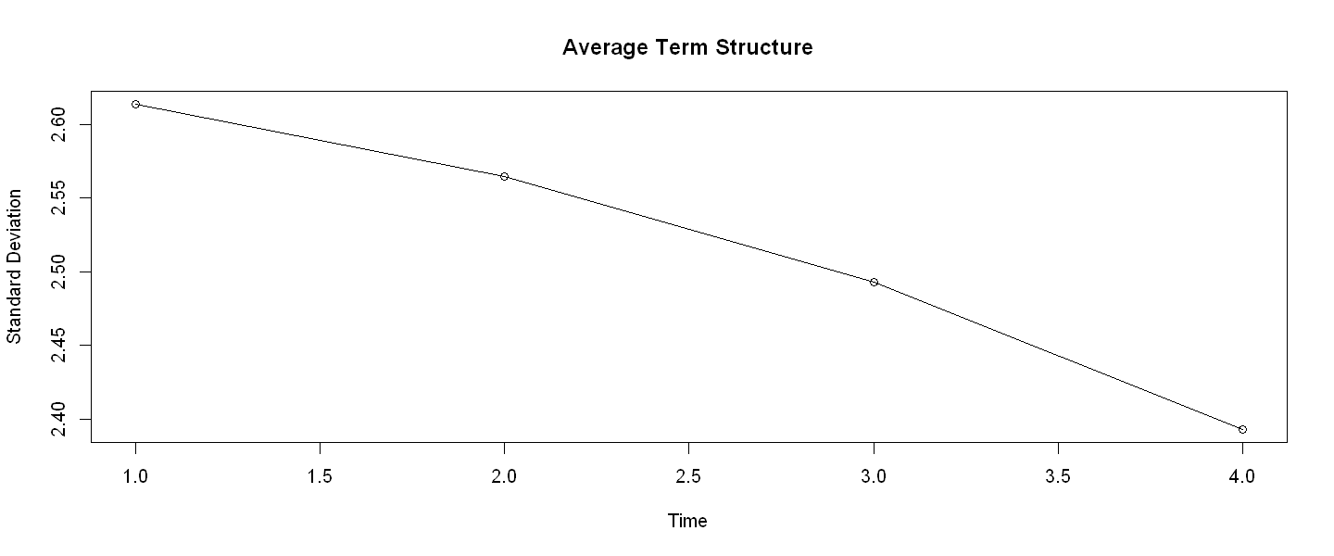
For USD
For CAD

Slide 10
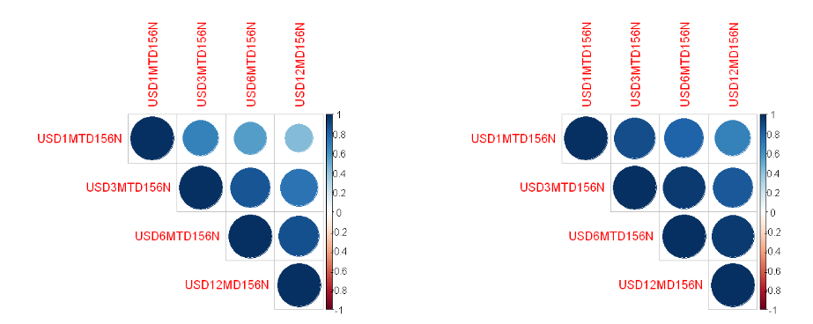
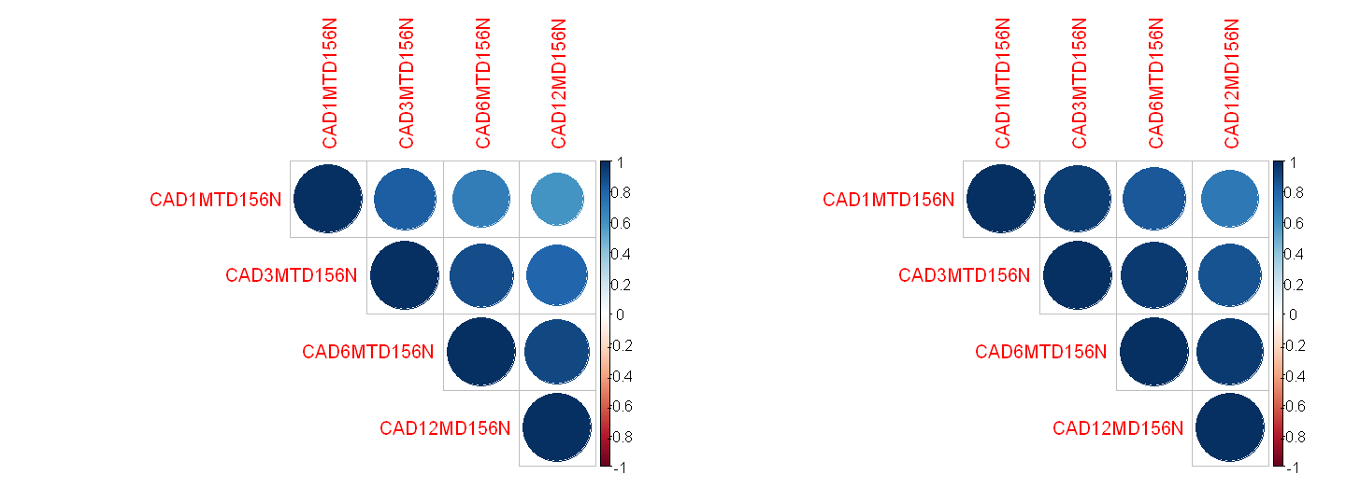
For USD
on the left :
1 day increments
on the right:
30 days increments
For CAD

Slide 11
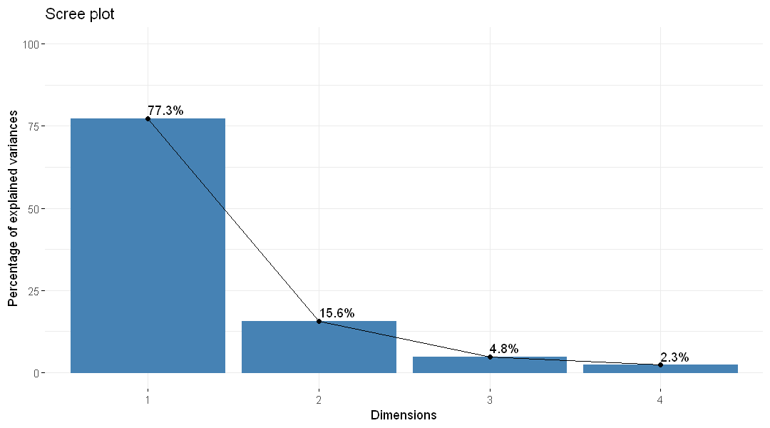
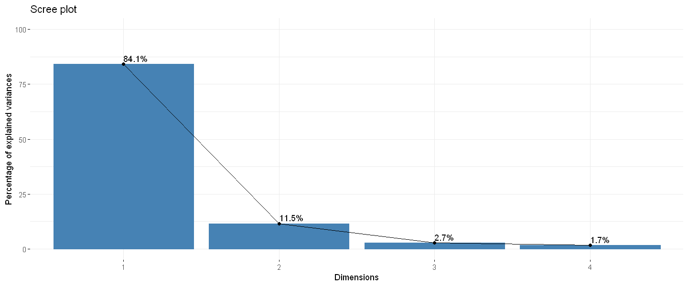
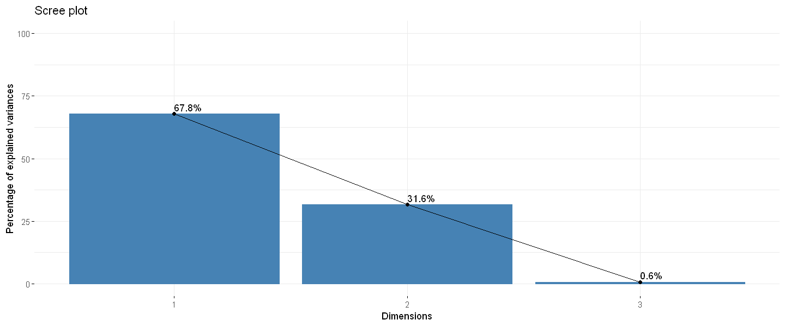
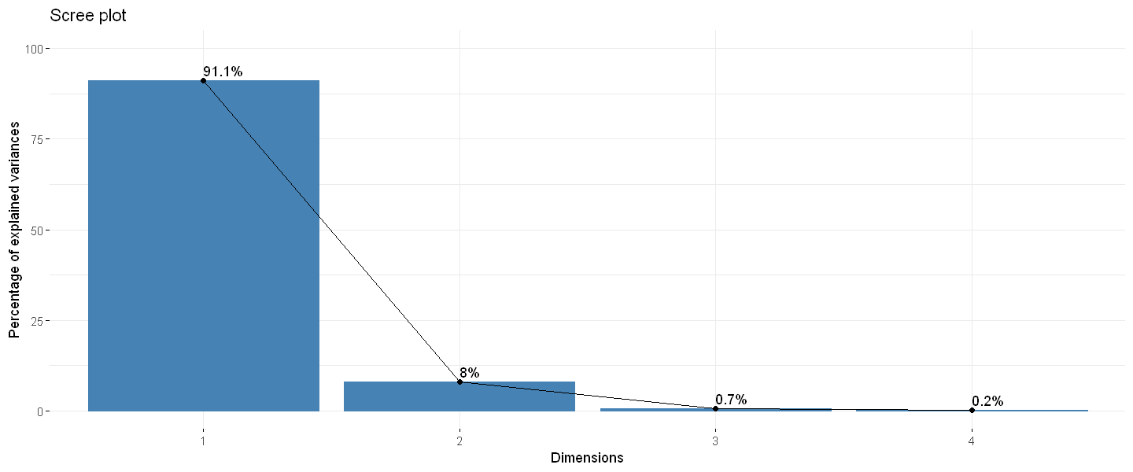
Principal Component Analysis (PCA) is a data reduction technique and its goal is to summarize the correlations among a set of observed variables with a smaller set of linear combinations.

Slide 12
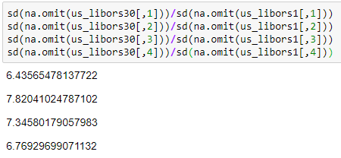
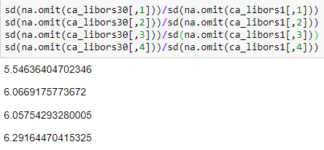
Scaling factor between increments

Slide 13
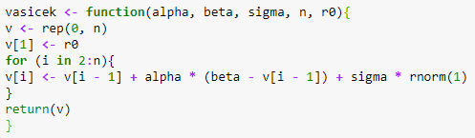

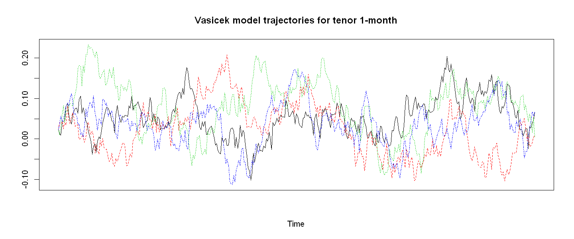
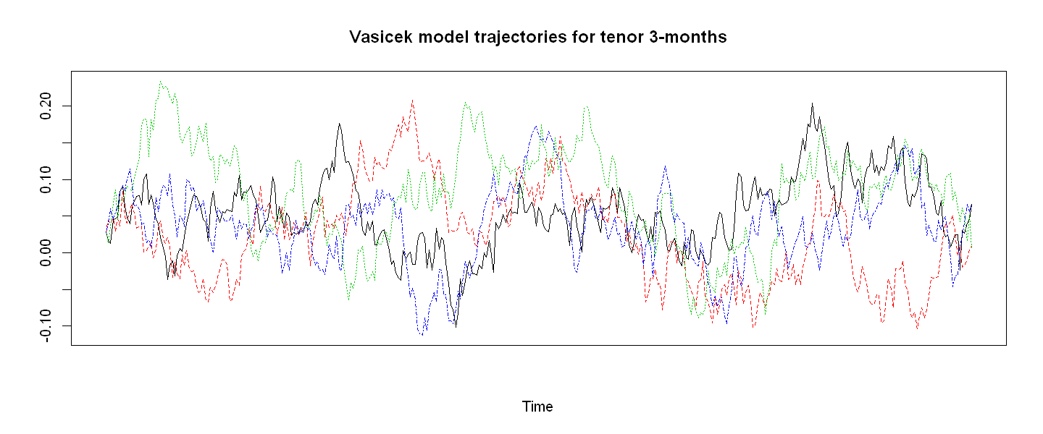
Vasicek model for tenors 1-month and 3 months (for USD only)

